Slide 1
Hierarchical clustering
Unsupervised ML

Slide 2
Hierarchical clustering is a type of unsupervised machine learning algorithm used to cluster unlabeled data points.
Like K-means clustering, hierarchical clustering also groups together the data points with similar characteristics.

Slide 3



Slide 4
HC
At the start, treat each data point as one cluster. Therefore, the number of clusters at the start will be K, while K is an integer representing the number of data points.
Form a cluster by joining the two closest data points resulting in K-1 clusters.
Form more clusters by joining the two closest clusters resulting in K-2 clusters.
Repeat the above three steps until one big cluster is formed.
Once single cluster is formed, dendrograms are used to divide into multiple clusters depending upon the problem.

Slide 5
distance between the clusters
The distance itself can be Euclidean or Manhattan distance or other.
Measure the distance between the closes points of two clusters.
Measure the distance between the farthest points of two clusters.
Measure the distance between the centroids of two clusters.
Measure the distance between all possible combination of points between the two clusters and take the mean.

Slide 6
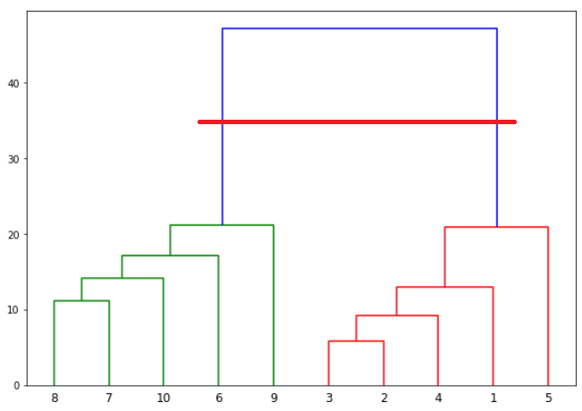
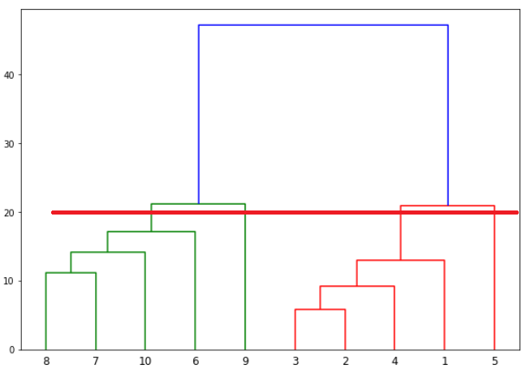
Number of clusters
The number of vertical lines this newly created horizontal line passes is equal to number of clusters.

